Slide 1
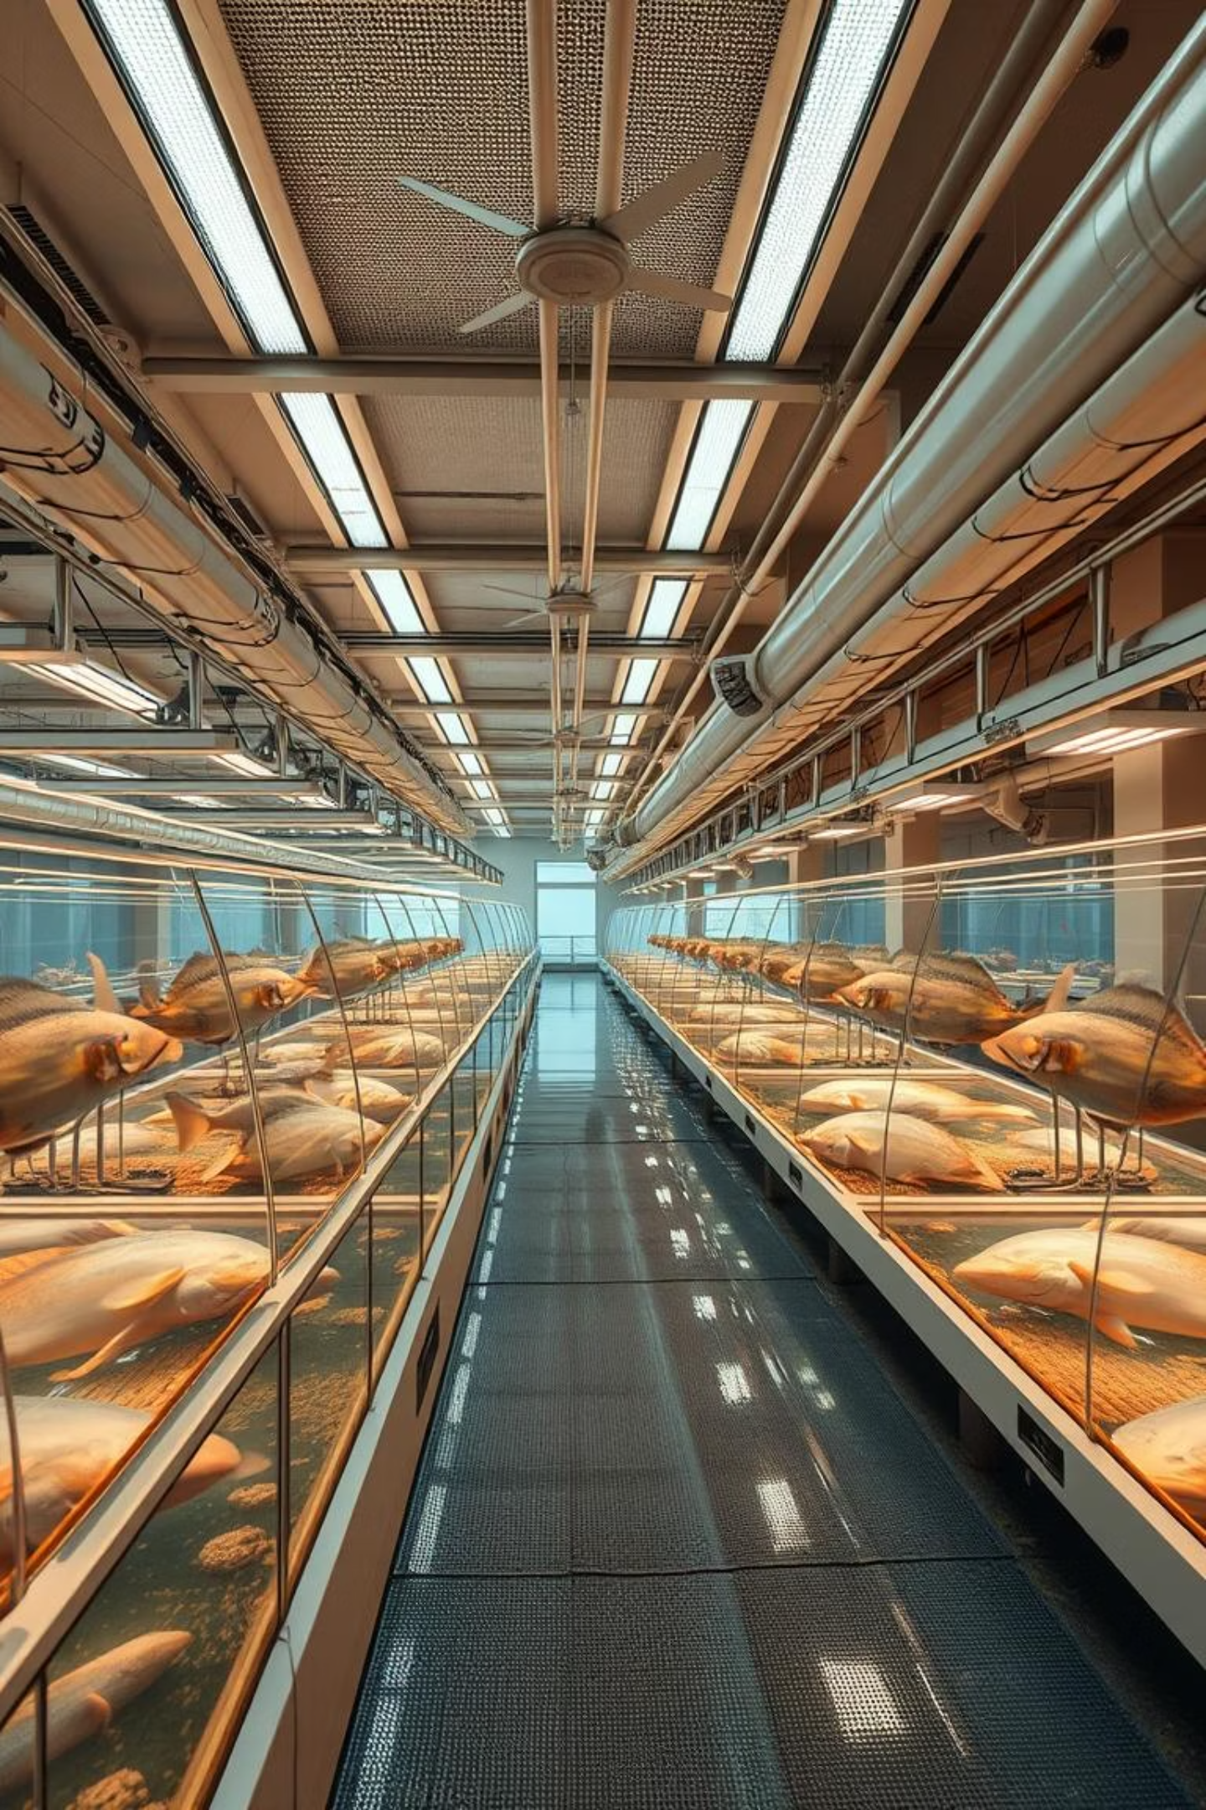
AI-Based Multimodal Fish Health Detector for Sustainable Aquaculture
V. Sanmuk Suresh-323129512070

Slide 2
The Challenge: Fish Stress & Disease in Aquaculture
Aquaculture is the fastest-growing food production sector, crucial for global food security. However, it faces significant challenges from fish stress and diseases, leading to mass mortality and economic losses.
"Early detection of health issues is critical, as delayed diagnosis often leads to large-scale mortality, reduced productivity, and financial losses for farmers."
Traditional monitoring methods are slow, labor-intensive, and prone to human error, often failing to identify subtle early signs of distress.

Slide 3





Our Solution: AI-Based Multimodal Detection
We propose an AI-based multimodal fish health detector leveraging computer vision and audio analysis for proactive, automated monitoring.
Data Acquisition
Data Preprocessing
Feature Extraction
High-resolution waterproof cameras and hydrophones collect visual and audio data.
Raw data is cleaned and enhanced; visual data isolates fish, audio data reduces noise.
Morphological, behavioral, and acoustic features are extracted from preprocessed data.
Machine Learning
Alert & Reporting
AI models (CNNs, RNNs) classify fish health, detecting anomalies and emerging issues.
System generates real-time alerts and regular reports on fish health status.

Slide 4
Feasibility & Implementation Plan
Feasibility Assessment
Project Implementation Phases
Technical: Leverages mature, open-source computer vision, audio processing, and ML technologies.
Week 1
Economic: Initial hardware investment offset by reduced fish mortality and improved productivity.
Project Initiation & Planning
Operational: User-friendly, automated system reduces human intervention, freeing staff.
Week 3
Data Acquisition System Setup
Week 6
Data Collection & Labeling
Week 10
Model Development & Training
Week 16
Final Report & Documentation

Slide 5
Technology Stack
A robust, scalable, and open-source technology stack ensures successful development and deployment.
Software
Hardware
Programming Language: Python
Cameras: High-resolution, waterproof IP cameras
ML Frameworks: TensorFlow, Keras, Scikit-learn
Hydrophones: Underwater microphones
Computer Vision: OpenCV
Processing Unit: Powerful computer with multi-core CPU and high-end GPU
Audio Analysis: Librosa
Web Framework: Flask
Database: PostgreSQL

Slide 6
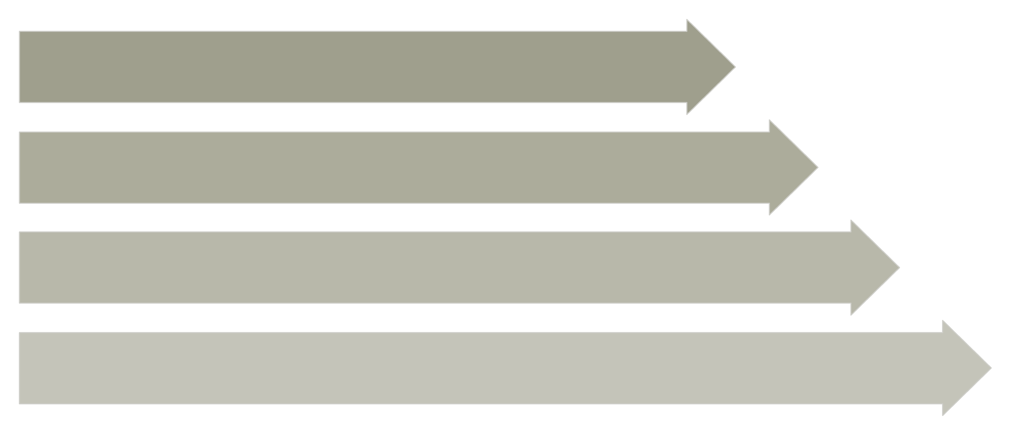
System Architecture
A distributed and scalable architecture handles large data volumes from multiple fish tanks.
Data Acquisition
Data Processing
Machine Learning
Application Layer

Slide 7
Python Implementation: Core Modules
The solution is developed in Python 3, using a modular structure for maintainability and scalability.
data_preprocessor.py
feature_extractor.py
Handles image (resizing, contrast) and audio (noise reduction, normalization) data preparation.
Extracts morphological, color, texture, spectral, and temporal features from data.
ml_models.py
main_application.py
Implements traditional ML (Random Forest, SVM) and deep learning (CNNs, multimodal) models.
Entry point for processing, training, and real-time monitoring simulation.

Slide 8
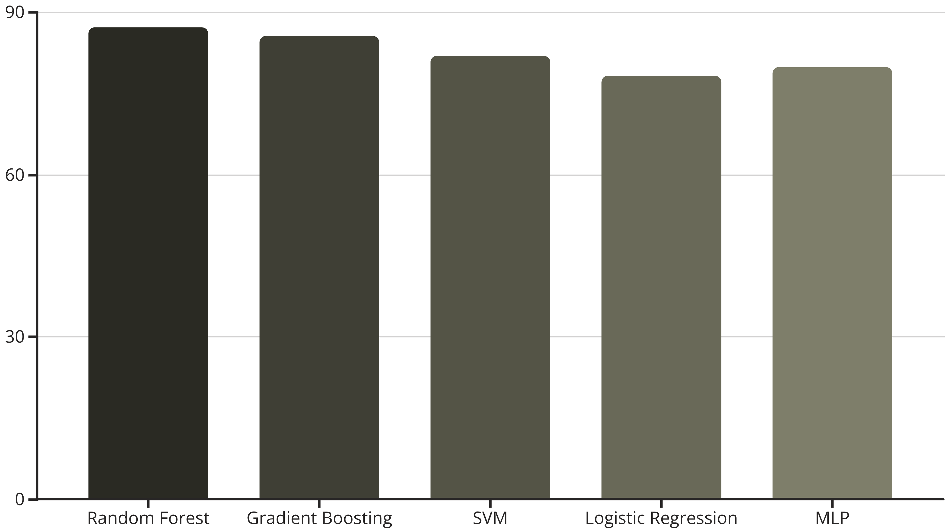
Performance Evaluation: Random Forest Leads
Evaluated on a synthetic dataset (300 samples: 60% healthy, 25% stressed, 15% diseased).
The Random Forest model achieved the highest accuracy of 87.33%, outperforming other traditional machine learning models.

Slide 9
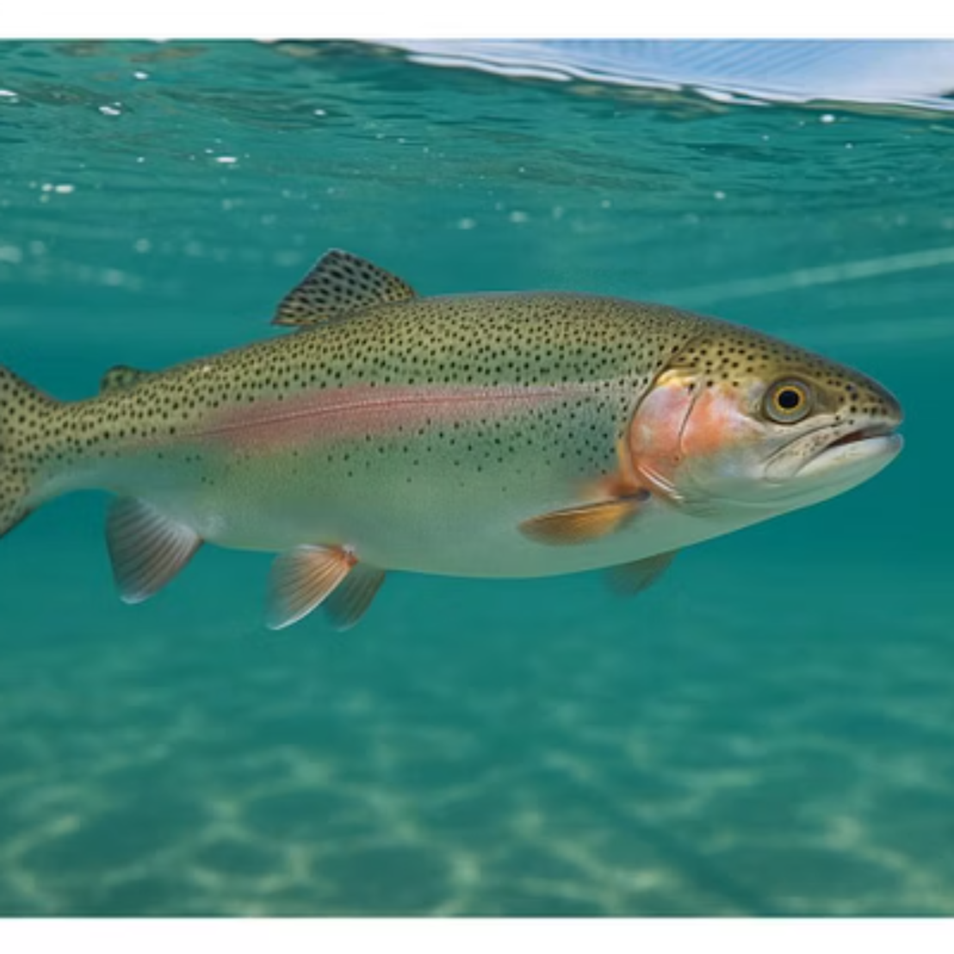
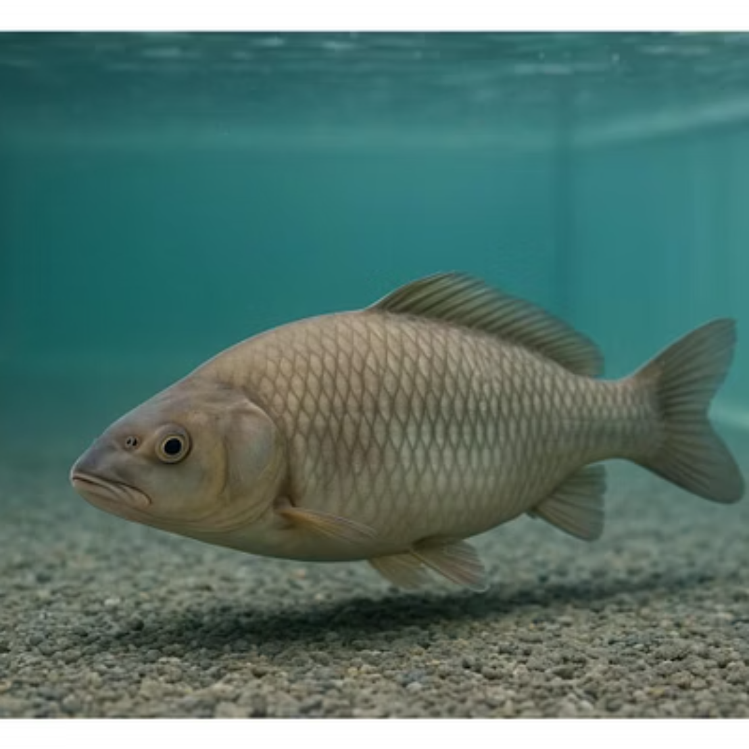
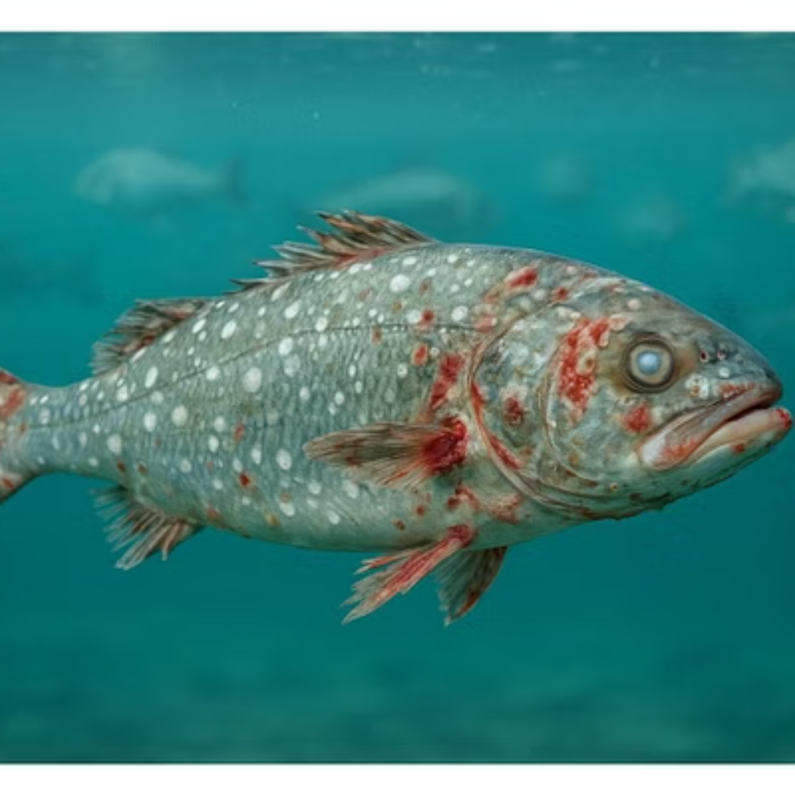
Visualizing Fish Health States
Sample images demonstrate the system's ability to differentiate between healthy, stressed, and diseased fish.

Slide 10
Future Work & Conclusion
Future Enhancements
Conclusion
Collect large, labeled real-world datasets.
This project successfully demonstrates the feasibility of AI-based multimodal analysis for fish health detection. Our system has the potential to revolutionize aquaculture by enabling early detection of stress and diseases, reducing mortality, improving productivity, and promoting sustainable practices.
Explore advanced deep learning models (e.g., attention-based, GANs).
Integrate with IoT devices for real-time environmental control.
Develop a mobile application for farmer access.

